Slide 1
Analysis and Prediction of Crash Severity in NYC
CS777 Final Project By Ziwen Lyu

Slide 2
agenda
Introduction
Research Questions
Methodology
Findings
Discussions & Conclusions

Slide 3
Introduction
Motor vehicle crashes are significant public safety issue, especially in population dense cities like New York City (NYC).
Suggest authorities to take preventive measure to reduce the collision frequency and severity.
If the model is able to predict severity with first-hand information, the authorities can prioritize and allocate emergency resources more effectively, as well as plan the management resourcefully.

Slide 4
Research Questions
Are certain boroughs in NYC and certain periods of a day more prone to have vehicle collisions in 2022?
How do certain crash factors like human behaviors (e.g., speeding, alcohol use) or environmental factors (e.g., road conditions) impact the severity in vehicle collisions?
Can we build a machine learning model based on crash first-hand information to predict crash severity?

Slide 5

Methodology - Data
The data is from the City of New York government, which contains every crash event in New York City from 2012 to 2024 with a least $1000 worth of damage. This data contains 2,124,646 unique crash events (rows) and 29 columns. (The data source: Motor Vehicle Collisions - Crashes - Catalog (data.gov))
This research will focus on 2022 with 103,886 crashes in NYC cities.
Features | Description | value
Crash date | The date when crash happened | “1/25/2022”
Crash time | The time when crash happened | “15:34”
Borough | The location where crash happened | “BROOKLYN”
Number of persons injured | The number of people injured in crash | 5
Number of persons killed | The number of people killed in crash | 1
Contributing factor 1 | The reason why the crash happened | “Alcohol Involvement”
Vehicle type code 1 | The type of vehicle involved in crash | “Bus”

Slide 6

Methodology - Data
Target variable – Severity Level
Death > 0 or Injuries > 4: Serious crash (0.06%)
4>= Injuries > 0: Moderate crash (36.6%)
No Injuries: No-injury crash (62.8%)
Merge serious crash and moderate crash in training and prediction.

Slide 7
Methodology - Feature Engineering
Binnig: 55 unique values for contributing factors, 355 unique values for vehicle types.
Binned contributing factors into 8 categories: driver’s improper operation (40.4%), distraction (25.7%), third party issue (3.7%), illegal behavior (1.8%), road issue (2.4%), vehicle defection (1.5%), other (24.3%).
Binned vehicle type into 10 categories: sedan(47.6%), station wagon(35.3%), bus(1.9%), truck(5.0%), bike(2.6%), motorcycle(0.9%), taxi(2.7%), van(0.6%), scooter(0.6%), other(4.4%).
Added time (“month”) and converted crash time into continuous data.
One-hot encoding all categorical features.
Polynomial Expansion: degree of 3.

Slide 8
Methodology – Model Evaluation
Weighted Logistic Regression:
We set the regularization equals to 1, and maximum iteration to 150.
Decision Tree:
We set the hyperparameter max depth as 5, max bins as 32.
Split the train and test data into 8:2.
Evaluated by F1-score.

Slide 9
Findings - associations
Time of day vs. Severity Level
The serious crash happened most during the evening (204, 0.2%). This might be due to the lightening and sight limitation. Both moderate and no-injury crash prone to happen during the afternoon (13367, 13.07%; 21393, 20.91%).
2. Month vs. Severity level
Serious and moderate crashes concentrated in June, July, and August month, while most no-injury crashes are in May, June, and March. The temperature might be another factor contributing to the severity level.
3. Contributing factors vs. Severity level
Driver’s improper operation (speeding, cell phones, etc.) is the main cause of crashes in NYC.

Slide 10
Findings – Model Performance
Decision Tree:
Accuracy 64%
Precision: 79%
Recall: 7.9%
F1: 14.3%
Weighted Logistic Regression:
Accuracy 56%
Precision: 44.8%,
Recall: 65.5%
F1: 53.2%
Actual/Predicted | Positive | Negative
Positive | 614 | 163
Negative | 7198 | 12516
Actual/Predicted | Positive | Negative
Positive | 5115 | 6311
Negative | 2697 | 6368

Slide 11
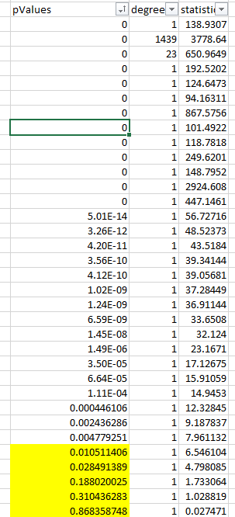
Chi-square test
The Chi-Square test shows most features had p-values less than 0.001, suggesting a strong significance with crash severity. So, the features we selected for the model are relevant predictors.

Slide 12
Discussions & Conclusions
By the comparison, we see the weights in logistic regression model greatly improve the performance as it can handle imbalanced dataset.
Polynomial expansion, regularization, binning more granularly, adjusting model hyperparameters…but there still remains a considerable gap from ideal scenarios.
Chi-square test shows we chose relevant features for predictions.
Need additional features from other data source to predict the crash severity level.
Association analysis shows, we could include more weather related features into the future study.

Slide 13
Thank you

